Slide 1
TA TRAINING POSTDOC HR
Vanessa Doriott Anderson, PhD
Interim Assistant Dean for Professional Development
Director of Teaching and Communication Programs
The Graduate School

Slide 2
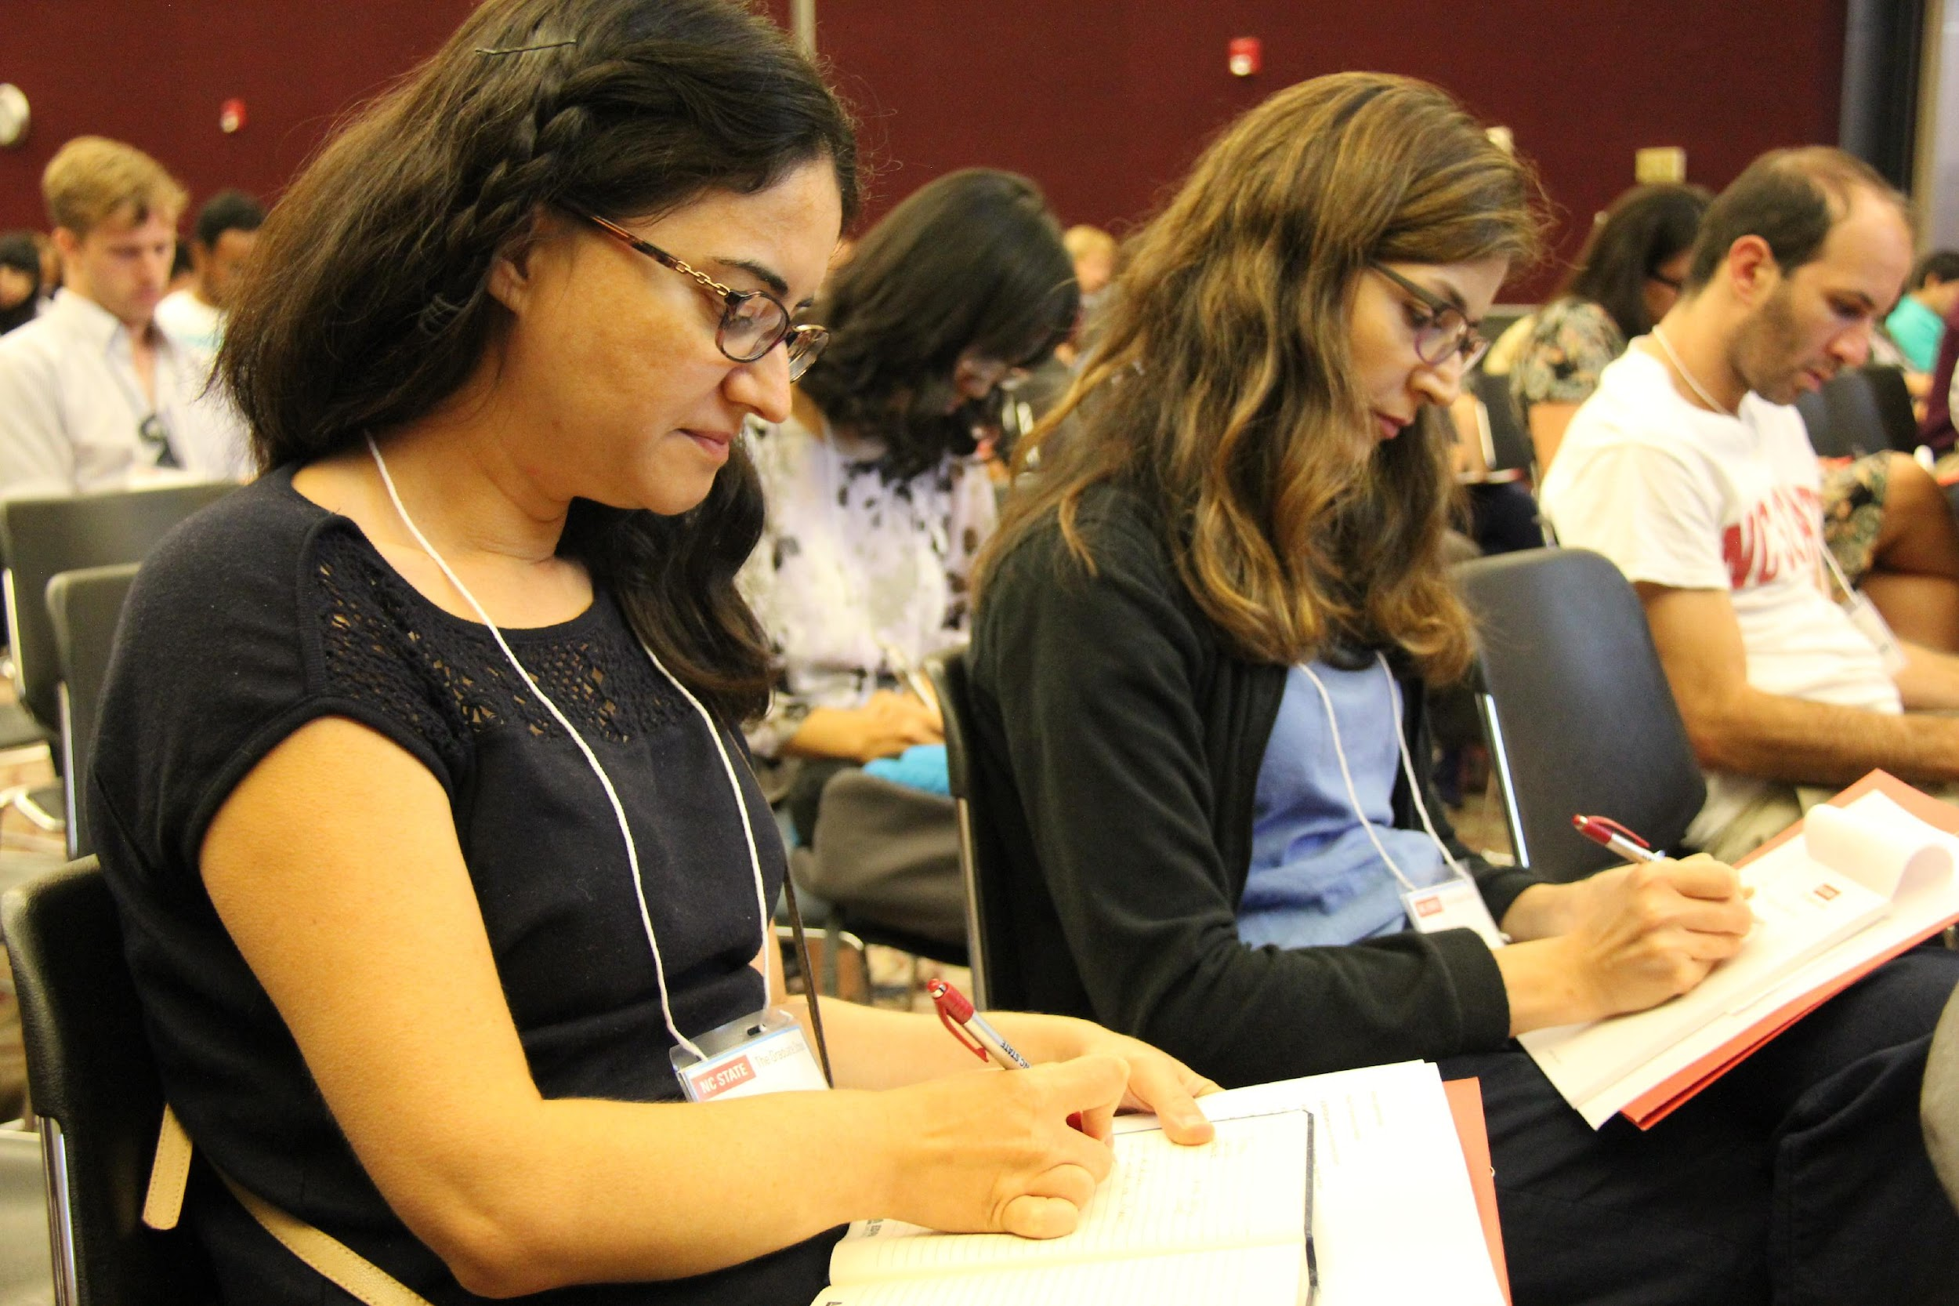
New TA Workshop ● Friday, August 12 ● go.ncsu.edu/taw

Slide 3
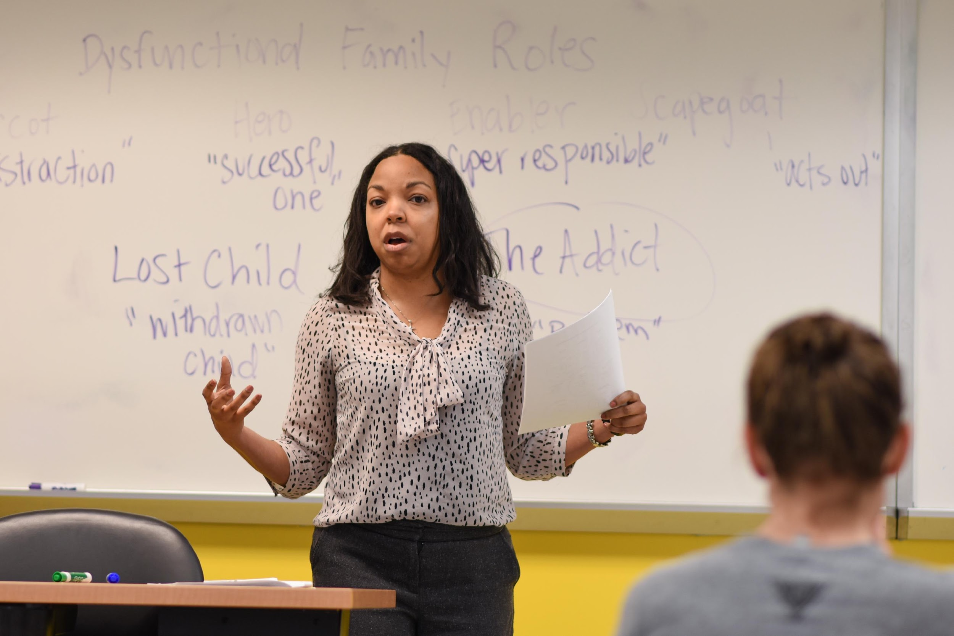
Certificate offerings are currently online (synchronous through Zoom) and are open to all graduate students and postdocs with an interest in teaching
Teaching and Communication Certificate ● go.ncsu.edu/tcc

Slide 4
Updates on New TA Workshop (2022)
In person at McKimmon (Friday, Aug. 12)
Plenary recording still available from last year
One full day of programming with morning plenary and afternoon breakouts
Priority is new TAs but all are welcome to attend
Registration opens June 6 at go.ncsu.edu/taw
Contact ● Vanessa Doriott Anderson ● 919.515.8676 ● vkdoriot@ncsu.edu

Slide 5
Frequently Asked Questions (2022)
Q: Is the New TA Workshop required?
A: The Graduate School does not require attendance; however, individual departments or colleges are free to make participation a requirement.
Q: My student can’t access the registration form. What should they do?
A: They should make sure they’re logged into their NC State Google account. This almost always solves the problem.
Q: How many times a year do you offer this training?
A: We provide a full-scale New TA Workshop once per year in August. However, we offer smaller-scale teaching and communication workshops throughout the year.
Contact ● Vanessa Doriott Anderson ● 919.515.8676 ● vkdoriot@ncsu.edu

Slide 6
Main Takeaway for HR Representatives:
The sooner you process TA hires, the sooner we can let those students know about the free training that can help them succeed in their role.
Contact ● Vanessa Doriott Anderson ● 919.515.8676 ● vkdoriot@ncsu.edu

Slide 7
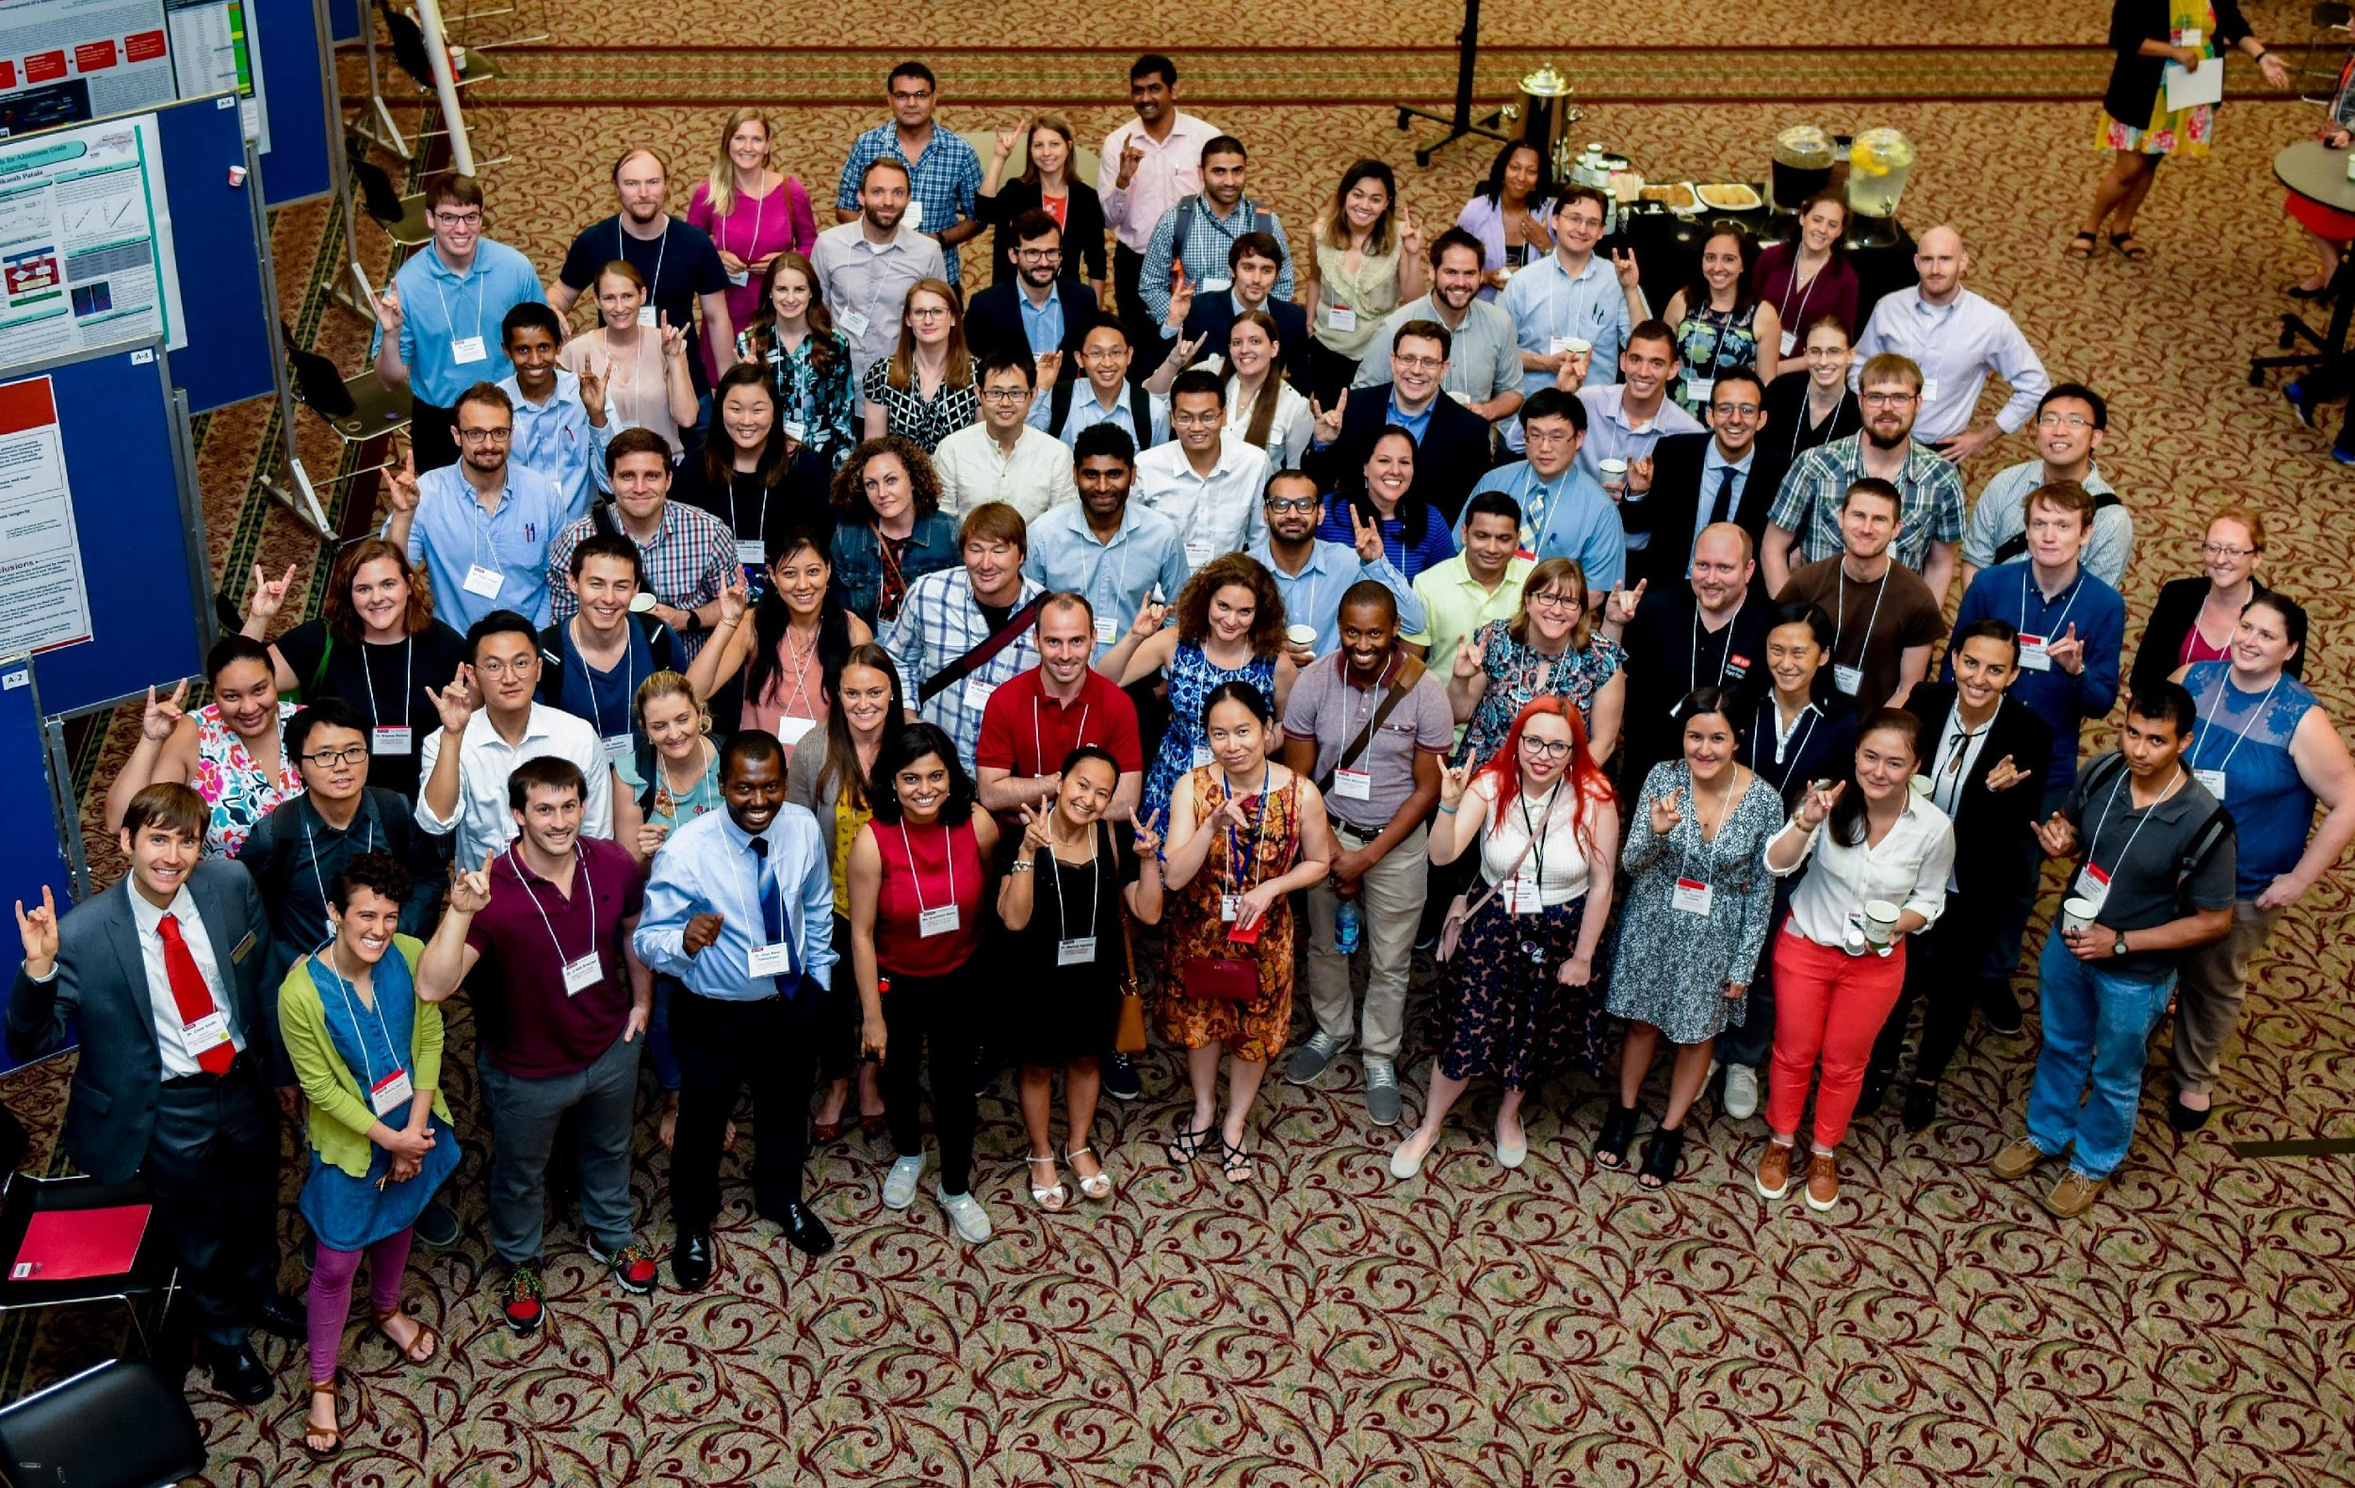
Postdoc HR ● Shawana Hodge ● postdocadmin@ncsu.edu

Slide 8
Updates on Postdoc HR (2022)
Expect delays
Actions are due by Thurs. noon to be processed with that week’s batch
Turnaround time (including Central HR) is 7-10 days
Hires outside the 5-year limit require a detailed justification
Health insurance premiums up 13% starting July 1
Contact ● Shawana Hodge ● postdocadmin@ncsu.edu

Slide 9
Frequently Asked Questions (2022)
Q: Can you process my urgent action immediately?
A: We will begin processing your action as soon as we can, but we do not own the entire process for most HR actions. For that reason, we ask you to anticipate 7-10 days.
Q: Where do I go with questions about HR? Where do I send postdocs with questions about benefits?
A: Our main account for postdoc HR is postdocadmin@ncsu.edu. More than one person monitors this account, which makes it ideal for queries! We can triage your messages to the right person from there.
Q: When do you plan to hire a new postdoc affairs program manager?
A: This summer, and we will announce it widely when it happens.
Contact ● Shawana Hodge ● postdocadmin@ncsu.edu

Slide 10
Main Takeaway for HR Representatives:
The earlier you initiate postdoc HR actions, the better. Everyone is short-staffed, everything is delayed, but we are doing our best to serve you.
Contact ● Shawana Hodge ● postdocadmin@ncsu.edu

Slide 11
Office of International Services
Phone: 919-515-2961
Location: 111 Lampe Drive, Suite 320
Email: ois@ncsu.edu
Website: www.internationalservices.ncsu.edu

Slide 12
What We Do
Manage NCSU’s F and J visa programs.
Advise F/J students on visa rules and issue visa documents.
Assist departments and university in supporting international students.
Provide campus and community programming.

Slide 13
Current Operations
In-person visits limited to confirmed appointments only
Phone hours
M, T, Th, F 8-12 and 1-5
Wednesday 8-12 and 2-5
Most of our services (open advising or “drop-in hours,” appointments, and OPT info sessions) will remain virtual for the time being
We will update our website as we update our operations
Notes:
When we discuss this I would say ‘ we have found virtual drop ins very popular- students no longer have to leave centennial campus to get to us, they can join from labs and library study rooms…

Slide 14
Staffing Update
As is the case with many university offices, we have experienced a fair amount of turnover since the pandemic began.
Four new advisors have joined in the last year
Ray Espinol
Lexi Hyde
Thor Duryea
Kory Sopko
Our Intake Specialist helps with student and departmental requests in GlobalHome. Her name is Kathryn Behling
OIS has three open positions for Intake Specialist, Advisor, and Programs Coordinator

Slide 15
Immigration Software Update
The majority of our student and scholar request processes are in our new system, “GlobalHome.”
We continue to build out and enhance GlobalHome by adding additional processes and functionalities.

Slide 16
Fall 2022 Orientation
OIS is excited to announce that International Orientation will be in-person this fall!
Talley Student Union
Wednesday, August 17, 2022
New international students on F and J visas should plan to arrive to Raleigh before that date.

Slide 17
Arrival Requirements (New Admits)
Ideally arrive in Raleigh on or before 8/17 (OIS orientation).
May arrive in Raleigh by 8/22 (first day of class) without permission.
Must arrive in Raleigh by 8/26 but only with permission from dept. to enter late.
If they cannot arrive by 8/26 they must defer their admission and plan to begin in Spring 2023 (this can have some consequences for CPT eligibility that can be discussed with OIS if there are questions).

Slide 18
Enrollment Requirements (AY 2022-2023)
Must be enrolled full-time (generally 9 credit hours) unless approved in writing by OIS for a reduced course load (RCL).
If student has a grad load waiver or have met minimum credit hours to enroll in only 3 research credits and are enrolled as such, no RCL is needed as they are coded in the system as full-time.
COVID exceptions to on-line course limitations
OIS is awaiting some clarification of guidance that was recently announced and will email separately on this.
OIS monitors enrollment and will notify student if there are issues.
Notes:
saving in case we need it for future:
Students whose F-1 status began after March 9, 2020: Must enroll in at least 1 in-person course.
Students whose F-1 status has continued since before March 9, 2020: No limit to online course enrollment
All J-1 students: While a limited hybrid option is available for J-1 students, a fully or predominantly virtual exchange program is not permitted

Slide 19
On-Campus Employment
GSSP changes: Students are no longer allowed to engage in GSSP or other on-campus employment from abroad (includes continuing students and new admits).
Remote work: OK for students to engage remotely from within the U.S. in their on-campus jobs from immigration regulatory perspective (out of state may still require HR approval).
Hours Limit: Max of 20 hrs/wk when classes are in session (Fall & Spring).
This is a regulatory limit. No one can make an exception or “approve” >20.
Each week is limited to 20 hrs; cannot average hours over 2 week pay period.
Students with .5 FTE assistantships are maxed out, cannot accept additional hrs.
Please review student’s current employment before adding more.
Fall 2022 20 hour/week limitation begins 8/20 .
Last day of on-campus employment eligibility for Fall graduates (and Spring no-registration students) will be 12/17/2022.

Slide 20
On-Campus Employment: Summer
Maximum allowed hours depends on whether Summer is first or final semester of enrollment.
If Summer Is…. | On-campus employment
First semester of enrollment | Maximum 20 hours/week
Final semester of enrollment | Maximum 20 hours/week. All appointments must end as of last day of final exams for Summer 2 (or potentially earlier if student applies for OPT based on defense date within the summer session.
Not first or final semester of enrollment | No hours limitation, OIS announces in student newsletter on our website the dates of summer during which students may exceed 20 hours per week of employment.

Slide 21
Off-Campus Employment
Off-campus employment is any employment not physically located on NCSU campus OR not paid by NCSU.
Still on-campus employment if paid by NCSU and normally occurs on campus but is currently conducted remotely from within the U.S. due to COVID.
Off-campus employment always requires written authorization from OIS and sometimes USCIS.
Encourage students to consult OIS re: any employment opportunity that takes place off-campus or is paid by an entity other than NCSU.
Most frequent situation we see unauthorized off-campus employment is when student is conducting research at another institution or working for a faculty member’s start-up.

Slide 22
As always, if you have any questions, please reach out to ask!
Thank you for all you do to support international students at NC State!

Slide 23
University Payroll

Slide 24
Most Important Question…

Slide 25
How do I get paid?

Slide 26
Why do students not enroll in direct deposit?

Slide 27
Answer: “I didn’t know I had to!”

Slide 29
Direct deposit is mandatory for employment at NCSU. Failure to Comply is grounds for dismissal (Reg# 05.45.01 – Direct Deposit of Pay)
New Hires enroll in Direct Deposit through Employee Self Service.
Rehires need to make sure direct deposit is still active. Re-enroll if no Direct Deposit information is Active.
Changes to direct deposit can be made through Employee Self Service.
Pre-notification is now completed for each new Direct Deposit account entered in the HR System in order to confirm the account information is correct.

Slide 32
Contact
Meghan Hart
Payroll Specialist
Phone: 919-513-7606
Email: meghan_hart@ncsu.edu
PAYROLL OFFICE
1220 Varsity Drive Campus Box 7233 Raleigh, NC 27695-7233
919-515-4350
919-515-4320 (Fax)
hrpayroll@ncsu.edu
Asha Logan
Payroll Specialist
Phone: 919-513-3548
Email: arlogan@ncsu.edu
Regina House
Payroll Manager
Phone: 919-515-4355
Email: rbhouse@ncsu.edu

Slide 33
TRANSPORTATION UPDATES
Demar Bonnemere, Communications Manager
Transportation Office

Slide 34
Parking Options
Graduate Student’s may purchase a permit through ncsu.aimsparking.com starting at 10:00 AM on July 14, 2022.
Permits are sold on first come first served basis and remain semester based. Fall, Spring, Summer I & II or Full Summer
Permit Type – “CB” (Centennial Biomedical) – permit is exclusively for Vet School students.
ES King and Western Manor students may purchase an RH or commuter parking deck permit (CB, CC, CD, DD, and W).
Dan Allen remains Graduate & Employee only.
Park & Ride Lots
Spring Hill, Carter-Finley, Food Lion on Avent Ferry
Must register for a free permit
To see where you permit is valid view our interactive parking map at go.ncsu.edu/interactiveparkingmap

Slide 35
Commuter 2-Year Parking Permit Rates
PERMIT TYPE | COST – 2021/2022 | COST – 2022/2023
CC | $210 | $210
CD | $210 | $210
DD | $210 | $210
CB | $210 | $210
F | $185 | $185
L | $80 | $80
V | $105 | $105
W | $210 | $210
Summer Session 1 & 2 | $50 | $50
Summer Full | $75 | $75

Slide 36
HOW TO CONTACT US
Phone:
919-515-3424
Email:
ncsu-transportation@ncsu.edu
Twitter:
@NCStateTranspo (Transportation Dept.)
@NCSUWolfline (Wolfline)
@NCSUWolftrails (Wolftrails)

Slide 37
INTERNATIONAL EMPLOYMENT, I-9s AND E-VERIFY
Jill Blitstein, International Employment Manager
Bernadette Clarke, I-9 Program Coordinator
June 3, 2022

Slide 38
International Employment
What we do:
Obtain nonimmigrant (temporary) status for faculty, staff or postdocs: H-1B, TN, E-3, O-1
Obtain immigrant (permanent) status via employment sponsorship for faculty or staff employees to get permanent residence (“green card”)
NC State cannot sponsor postdocs for green cards

Slide 39
International Employment
Common HR employment issues for foreign national graduate students in F-1 status:
After graduation and after F-1 I-20 immigration document has expired, student cannot continue to work unless they have a valid EAD (employment card) in-hand
This may lead to gap in employment between I-20 end date and date student receives EAD card in mail
Student cannot work even if EAD card is in-hand IF the start date on the card is a future date
No “volunteering” during this period – violation of university guidelines regarding unpaid work
Program end date on the I-20 form is the end date for employment authorization and is the date HR is tracking
If I-20 date changes, unit needs to complete an updated I-9 form with student, to track new employment end date

Slide 40
I-9 Program
I-9 Employment Eligibility Verification Form
Required for all new hires (and some rehires) to university within a certain period of time
Also required for new foreign students without SSNs!
I-9 Guardian: our electronic I-9 system in which we complete and store our I-9 forms
Only trained and licensed system Users can complete I-9s for NC State
Foreign national students might have multiple I-9 forms, if program end dates (and therefore employment end dates) keep changing

Slide 41
I-9 Program
E-Verify program
Federal database that verifies employment eligibility of new hires; required use per state law
I-9 Guardian system sends I-9 data to E-Verify system electronically, but
Valid SSN is required to send data to the E-Verify system
New foreign national grad students MUST apply for and receive a valid SSN before we can finish the required E-Verify process

Slide 42
I-9 Program
I-9 Reminders:
Foreign national graduate students can start working before they check in with OIS; BUT
Until OIS updates the government’s SEVIS system (during check-in), we will have issues with E-Verify (inability to verify immigration status)
E-Verify instituted a new rule: we only have 10 days from notification of an E-Verify issue in which to address it - OIS can’t always get to this within 10 days!
Big issue every July/August/September
Still must timely complete I-9; we just have to wait to do E-Verify

Slide 43
I-9 Program
I-9 Reminders:
The I-9 start date can/should be the date that the person actually shows up and starts to perform the services
Does not have to be the official first day of the semester or any other required “system” date
Communicate actual start dates of grad students with your I-9 Users in your college or department!
Can still complete I-9 even if job action is not in JAR or NextGen yet
Please email I9questions@ncsu.edu with ID#, start date and active email address for us to create the I-9.

Slide 44
Graduate Assistantships & Fellowships
Richard Corley

Slide 45
What are Assistantships?
Graduate assistantships are a type of student employment:
Intended to be training positions that supplement classroom training and furthers the student’s degree.
Work should be associated with the graduate student‘s academic curriculum.
Paid Bi-weekly
International students must have a Social Security (SSN) and Tax Assessment.
Do not track hours worked

Slide 46
Eligibility Requirements
Fully admitted
Enrolled full-time
Good academic standing
+3.0 GPA
Types of Assistantships & Job Codes
Graduate Research Assistants (A148)
Graduate Teaching Assistants (A138)
Graduate Teaching & Research Assistants (A178)
Graduate Services Assistants (A198)

Slide 47
Hours / FTE
Graduate Students may work up to 29 hours, 0.725 FTE combined with all other on-campus appointments.
International students on F-1 visas are restricted to 20 hours,0.5 FTE combined with all other on-campus appointments while enrolled.
Can a student work over 29 hours?
Yes, with College Dean approval in Next Gen
Students working more than 29 hours can lose their FICA tax exemption.

Slide 48
Appropriate Dates
Teaching Assistantships | Other Assistantships
Can work throughout the year during specified periods. | Allowed anytime throughout the year.
Fall Semester: 8/16/20xx – 12/31/20xx Spring Semester: 1/1/20xx – 5/15/20xx Academic Year: 8/16/20xx – 5/15/20xx *New Summer I: 5/16/20xx – 6/30/20xx *New Summer II: 7/1/20xx – 8/15/20xx *New Full Summer: 5/16/20xx – 8/15/20xx | We encourage the use of semester dates, however, alternative begin and end dates are allowed.
International students may continue to receive compensation after graduation, but must stop working. | International students who are graduating must be terminated from their assistantship as of the date of graduation.
Domestic students may be hired the summer prior to their fall admit term. International students have visa work restrictions and cannot be hired more than 30 days in advance of their I-20 start date. | Domestic students may be hired the summer prior to their fall admit term. International students have visa work restrictions and cannot be hired more than 30 days in advance of their I-20 start date.

Slide 49
What are Fellowships?
No Work Obligation Awards
Not considered employment
Payments are not considered wages
Can be funded by the Grad School, College, or Department
Disbursed through monthly payments
Eligibility Requirements
Fully admitted
Enrolled full-time
Good academic standing
+3.0 GPA

Slide 50
Fellowship Specific Information
Fellowships are disbursed on a monthly basis through the Financial Aid Systems in SIS, not HR.
Direct deposit with Cashier’s Office is required.
Processed within financial aid year, 8/1/20xx - 7/31/20xx.
International Students must have a tax assessment to receive award but do not need SSN.
Primary Fellowship | Supplemental Fellowship
At least $3,000/semester or more | Less than $3,000/semester
Eligible for GSSP benefits | Do not qualify for GSSP benefits

Slide 51
Calendar Deadlines
grad.ncsu.edu/faculty-and-staff/student-funding/
Next Gen is currently open for Fall 2022 GA appointments as of May 18th.
Auto-Term rows are entered Wednesday night, three weeks prior to the expected job end dates.
Rehires cannot be entered until after the separation is completely processed and modifications must be entered prior to the auto-term.
For August 15th job end dates, the auto term will run on July 27th.
All Modifications should be made prior to July 27th .
After July 27th, you can only enter New Grad Appointments or Rehires.
Individuals on active/qualifying appointments have until Census (Sept 2nd) to sign up for payroll deduction for student fees.
Payroll Calendar Important Dates
The 2022-2023 bi-weekly payroll calendar has not yet been published.

Slide 52
Updates
Appointments can be entered up to 90 days before its start date (increased from 60 days). This applies to New Grad Hires, Rehires and Modification actions. Separations are still 60 days in advance.
T&C letters generated within the NextGen system now includes the NC State Employer Identification Number (EIN) used by international students when applying for their SSN.
The GTA (A138) job code should now be used during the summer months for graduate students with only teaching responsibilities. This replaces use of the GSA (A198) job code with account code 51311 (instruction).
NextGen System Manual (Updated for 2022)
Summer I | 5/16/20xx – 6/30/20xx
Summer II | 7/1/20xx – 8/15/20xx
Full Summer | 5/16/20xx – 8/15/20xx

Slide 53
Best Practices
All appointments should be entered prior to the start date so that students can be paid in a timely manner. Failure to do so may delay their first paycheck.
Please monitor the progress of your NextGen actions using the Graduate Worklist.
Retroactive transactions more than thirty (30) days in the past requires Graduate School approval before submission.
If an overpayment occurs, please contact the Graduate School and University Payroll HRPayroll@ncsu.edu immediately. Hiring departments should be proactive about making salary adjustments in a timely manner to avoid a repayment situation.

Slide 54
International Admissions
International Students Coming from Another US Institution: These students are transferring their current immigration record to NC State.
Legally cannot work at NC State before date of immigration transfer – Hayley Hardenbrook, International Admissions Specialist in the Graduate School, has that date if need to confirm (hdharden@ncsu.edu)
If transferring, can work over summer before start of program without being enrolled, as long as transfer date has passed

Slide 55
Assistantship & Fellowship Resources https://grad.ncsu.edu/faculty-and-staff/student-funding
Grad School Form Page- https://grad.ncsu.edu/faculty-and-staff/forms/graduate-school-forms/ Important and frequently used Grad School forms and documents.
Grad Payroll Worksheet- Auto term schedule, payroll calendar and payroll monitoring tools.
NextGen System Handbook- (Updated for 2022) System description, transaction step-by-step instructions (w/ screenshots), common error messages and more.
NextGen Quick Guides- One-to-two page set of instructions for faculty and students.
Bi-weekly Calculator- Calculate annualized salary.
Queries
FAQs

Slide 56
Training
To request Assistantship and Fellowship training contact:
Richard Corley, Coordinator Graduate Appointments & Fellowships
rbcorley@ncsu.edu
To view previous Graduate Assistantship and Fellowship training videos, please visit:
https://grad.ncsu.edu/faculty-and-staff/gsc-resources/meetings-and-updates/

Slide 57
Graduate Student Support Plan (GSSP)
Dare Cook
GSSP Manager

Slide 58
What is the GSSP?
The Graduate Student Support Plan (GSSP) is a financial support package to attract top students to NC State University.
Graduate students eligible for the Plan receive tuition* and health insurance benefits at no cost to them.
*Semesters of eligibility

Slide 59
Size & Scope – FY 2022
Participation:
Over 3,400 students; ~ 53% of all on-campus graduate students
Funding:
Over $57.6 million
$ 40.7M – Graduate School (Provost allocated funding)
$ 16.9M – Other Funding Sources (non-state funding sources, including grants)
$13.1M from Contracts & Grants

Slide 60
SIS
(Student Information System)
Financials
HR
GSSP

Slide 61
Eligibility Requirements
Active in an on-campus Master’s or PhD degree program
Distance Education (DE) and graduate certificate program students do not qualify for the Plan.
Active, qualifying graduate appointment
Fellowship, RA, TA, RA/TA, or Extension Assistantship
At least, $8,000 annualized
Begins on or before Census Day
Must extend, at least, 30 days beyond the first day of classes (to initially qualify) and through the semester’s duration to receive full benefits.
Enrolled full-time, at all times
Within allowed semesters for tuition support (fall & spring only)
Master’s – 4 semesters
PhD with a previous master’s – 8 semesters
PhD without a previous master’s – 10 semesters
*See GSSP Eligibility Summary for complete details.

Slide 62
Receiving Benefits
Once a student actively meets all eligibility requirements ahead of Fall or Spring semester, OR once the department commits to fund the student on the Gradate Support Roster, the Graduate Support System automatically:
Creates a tuition award,
Adds the student to the NCSU RA-TA Health Insurance Plan
(8/1 or 1/1), and
Applies benefits to the student’s billing account.
BUT, timely action on the part of the student and appointment sponsoring program is important. The student is ineligible for GSSP benefits if eligibility requirements are not met by Census Day each semester.
If a student fails to meet all GSSP eligibility requirements at all times, they may lose all or a portion of their benefits.

Slide 63
Salary Redistributions
GSSP process captures funding data as of Census Day
Any changes after Census are not captured, even if backdated
HR actions impact financials and GSSP
Departments must notify the graduate school if SDC’s impact state funds.

Slide 64
GSSP Timeline – Fall 2022
March
3/28 - Fall Enrollment Begins
May/June
July
August/
Sept
5/15 – Begin reviewing Fall exceptions
7/7 – Fall billing begins
3/28 GSSP roster open for Commit to Fund (CTF)
8/22/2021 –First day of Classes
3/28 GSSP Exception Form – Open for fall
5/16 – NextGen Open for Grad Appt Entry
6/1 – Students with CTF will be reported to BCBS for enrollment in GSHI - daily through Census
7/27 - Fall bills due
7/29 – Fall schedule cancellation for non-payment
7/31 – 2021/2022 GSHI plan year ends. Students not CTF for fall by this date will have insurance terminated unless/until they qualify for fall.
8/26 – Commit to Fund flag removed for students not meeting GSSP requirements; students billed full amount due in September
9/2 – Census Date
9/2 – Deadline to submit GSSP exception form
By 9/15 – GSSP tuition and health insurance Journals Posted
8/26 – GSSP roster closes for updates
8/27/2021 - Census Date

Slide 65
Key Reminders
TIMING
Billing date
Bill due date
Spring Health Insurance Termination
Fall appointments should be entered now
Communicate with the student’s academic home department if they are working outside of the department
Eligibility
Exceptions
Commitment to fund

Slide 66
GSSP Resources for Administrators
Gradute Support Roster (eliminates the need for many queries)
Data Requests :
https://grad.ncsu.edu/faculty-and-staff/forms/
https://form.asana.com/?k=9IlkD-4DyoIsQVS-4dDMYw&d=941899506210581
GSSP for Administrators:
go.ncsu.edu/gssp-admin

Slide 67
Training
To request GSSP training contact:
Dare Cook, GSSP Manager
decook@ncsu.edu
GSSP Roster Refresher drop-in zoom sessions:
Friday, June 10 and Friday, June 17 2-4pm
To view a previous GSSP presentation for researchers:
https://reporter.ncsu.edu/index.html
search GSSP

Slide 68
Questions???

