Slide 1
WELCOME!

Slide 2
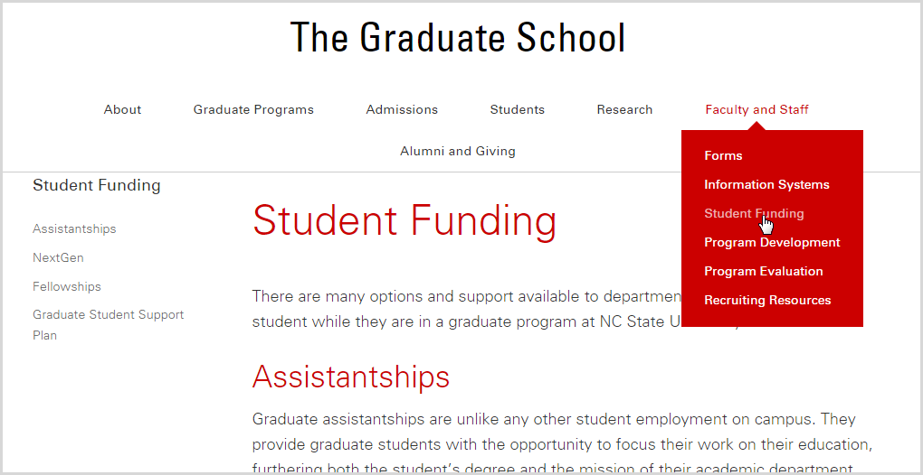
Website Resources
grad.ncsu.edu/faculty-and-staff/student-funding/
Find FAQs, manuals, calendars, policy explanation and more on our website!

Slide 3
University Payroll

Slide 4
Most Important Question…

Slide 5
How do I get paid?

Slide 6
Why do students not enroll in direct deposit?

Slide 7
I didn’t know I had to!

Slide 8
Direct deposit is mandatory for employment at NCSU.
New Hires enroll in ESS
Rehires need to make sure direct deposit is still active. Re-enroll if no info.
Give pamphlets to students and tell them to read it. Everything they need to know to get paid is in it.
Changes to direct deposit can not be made in ESS.

Slide 9
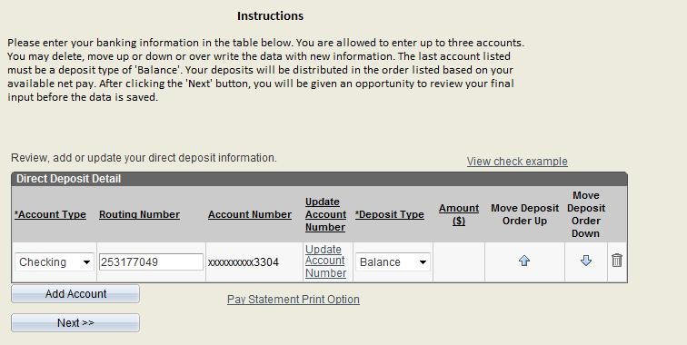

Slide 10
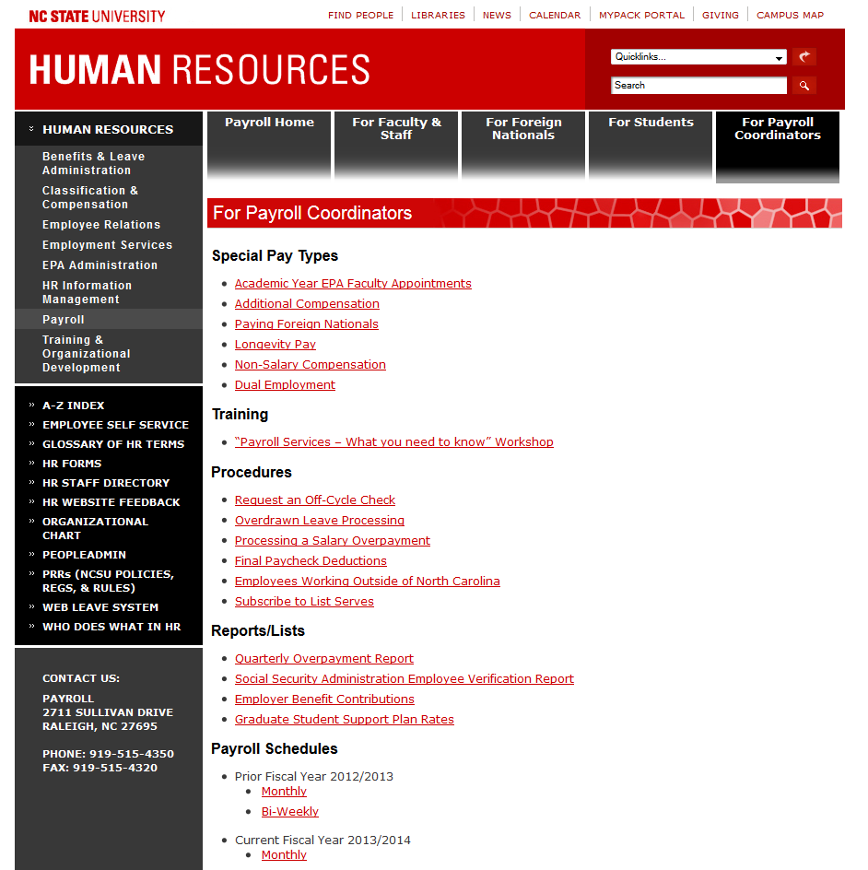

Slide 14
Contact
Meghan Kosbe
Payroll Specialist
Phone: 919-513-7606
Email: meghan_kosbe@ncsu.edu
Regina House
Payroll Supervisor
Phone: 919-515-4355
Email: regina_house@ncsu.edu

Slide 15
International Employment
Brief Overview for the
Graduate HR Personnel Meeting
July 12, 2016

Slide 16
International Employment
IE is a unit within Central HR:
Admin Services II building, Suite 110 (First Floor), Campus Box 7210
General IE email address: i9questions@ncsu.edu
OIS (Office of International Services) is a separate unit, not combined with IE and not part of HR. OIS offers services for F-1 (student) status and J-1 exchange visitor) status.
Mission statement: IE assists NC State to successfully employ and retain foreign nationals needing employment sponsorship on a temporary or permanent basis. IE is also responsible for monitoring and auditing the I-9 and E-Verify processes. IE stays current with relevant university, UNC-GA, state and federal regulations and policies.

Slide 17
International Employment
What we do:
Obtain nonimmigrant (temporary) status for faculty or staff employees: H-1B, TN, E-3, O-1
Obtain immigrant (permanent) status for faculty or staff employees: employment sponsorship to get permanent residence (“green card”)
I-9 and E-Verify employment verification processes
Review and audit I-9 forms
Manage and assist with E-Verify process

Slide 18
International Employment
Nonimmigrant (temporary) status is limited in time, scope and location
To start process, department must send completed Department Sponsorship Form and Checklist (with other listed documents) to IE
http://www.ncsu.edu/human_resources/intemployment/h1bdptinstruct.php
Immigrant (permanent) status is unlimited
To start process, department must send completed Initiation of Permanent Residence Process form to IE
http://www.ncsu.edu/human_resources/intemployment/permresprocess.php

Slide 19
International Employment
I-9 Employment Eligibility Verification Form
Required for all new hires (and some rehires) to university
We use an electronic I-9 system (I-9 Guardian) to complete and store our I-9 forms; only trained Users can complete I-9s for NC State
I-9/E-Verify page: http://www.ncsu.edu/human_resources/intemployment/i9.php
Users List: http://www.ncsu.edu/human_resources/intemployment/i9guardian.php
E-Verify program
DHS web database system with Social Security Administration and employers to verify employment eligibility of new hires
I-9 Guardian system sends I-9 data to federal E-Verify system
Valid SS# is required to input the query into the database

Slide 20
International Employment
I-9 Reminders:
Foreign national graduate students (in F-1 or J-1 status) should NOT start working (or be put into the I-9/E-Verify system) until AFTER they have checked in with OIS, because OIS must update the government’s SEVIS system first – otherwise we will have issues with E-Verify! *Big issue every July/August!*
The I-9 hire date can/should be the date that the person actually shows up and starts to perform the services
Does not have to be the official first day of the semester if that is not when the work starts, even if the HR system reflects the first day of the semester for payroll and benefits other purposes
Communicate with your I-9 Users in your college or department!

Slide 21
International Taxation
Graduate Personnel Representatives Meeting

Slide 22
Contact Information for International Taxation
Michelle Anderson, International Taxation Manager
mranders@ncsu.edu; 515-4370
Karen Lundin, International Taxation Specialist
kdlundin@ncsu.edu; 513-3437
Hayley Hardenbrook, International Taxation Specialist
hdharden@ncsu.edu; 513-3846
General e-mail address: ietquestions@ncsu.edu

Slide 23
Meetings
All Foreign Nationals who are receiving any form of compensation from the University are required to meet with International Taxation.
Please ask your Foreign Nationals to use the link below to schedule an appointment:
https://www.ncsu.edu/human_resources/payroll/Foreign_Nationals.php

Slide 24
Why is it so important for our Foreign Nationals to meet with International Taxation?
Foreign Nationals have a special set of tax guidelines that they must follow. Not being in compliance puts both the University and the Foreign National at risk of very large penalties and fines.
Foreign Nationals should meet with International Taxation, BEFORE THE PAYMENT IS PROCESSED. Does not matter if its paid through Payroll or Accounting.
Most Foreign Nationals are exempt from Social Security and Medicare taxes. They will not receive this exemption automatically unless they meet with International Taxation.
***This may impact your budget.***

Slide 25
Types of Taxable Compensation Per IRS
The IRS considered these items to be taxable income to a foreign national visitor:
Wages
Assistantships
Scholarships
Fellowships
Stipends
Travel Reimbursements
Housing Allowances – even if paid directly to University Housing.
Partnering with International Taxation before payments are issued can significantly lessen the tax burdens for both the visitor and to the department.

Slide 26
Scholarships
Scholarships are paid through the Financial Aid Office.
Scholarships paid to Foreign Nationals will not be dispersed until the Foreign National completes a tax assessment.
In the Financial Aid system there is a “hold mechanism” which is controlled by International Taxation.

Slide 27
Payments to Employees Working Outside of the United States
If you have a foreign national or US citizen working outside of the United States you must notify the International Taxation.
We may be required to collect certain documentation before the employee is sent abroad.
We may have employment and taxation requirements in that country.
We need to partner with your office as soon as possible.

Slide 28
Contact Information
For appointments please e-mail:
ietquestions@ncsu.edu
Or
Go to online:
https://www.ncsu.edu/human_resources/payroll/Foreign_Nationals.php

Slide 29
Questions?
Thank you!

Slide 30
Office of International Services

Slide 31
OIS – Important Employment Reminders
Graduate appointments for international students cannot exceed .5 FTE during Fall or Spring Semester, and total employment must be less than or equal to 20 hours.
The Graduation date of each term is what we use for the ‘end’ of the semester
International Students may be full-time during semester breaks ONLY if they are “vacation” terms – meaning only if they have completed a semester/term AND will register the following semester (so not if summer is first or last term)
Students who complete their programs can ONLY work beyond the end date of their I-20 with a valid Employment Authorization Document or other visa status allowing employment

Slide 32
Transportation Parking-Wolfline-GoPass
David Gregory, Parking Business Mgr. dwgrego2@ncsu.edu

Slide 33
Graduate Parking Options
Pay Roll Deduction
Must have appointment letter with dates starting July1st or latter till the end of December or through May.
Qualified Graduate Students (Research Assistants -Teaching Assistants – Resident Directors)
To Apply: My Pack Portal-Compensation and Benefits-Request Parking Permit- All actions must be entered before link will open.

Slide 34
Graduate Parking Options
Graduate Students were eligible to purchase through our website www.ncsu.edu/transportation starting July 5th.
Payment (credit card) is due at time of purchase
Unable to provide third party billing (financial aid)
Permits can be mailed or picked up at the discretion of individual

Slide 35
Graduate Parking Permits
Eligible for student parking permit based on commuter or resident status.
Their Student Status overrides any part time or temporary job they have at the University.

Slide 36
Wolfline
All Students and Employees are eligible to ride the Wolfline.
Plan trips between campuses using the Wolfline
Carter-Finley free Park and Ride option

Slide 37
GoPass
GoPass is a Regional Bus Pass that allows trips on GoTriangle and GoRaleigh
Graduate Students cost is $5 and must be purchased on line.

Slide 38
Graduate Student Support Plan (GSSP)
Caroline Ortiz-Deaton The Graduate School

Slide 39
What is the GSSP?
The Graduate Student Support Plan (GSSP) is a financial support package used to attract top students to NC State University.
Graduate students eligible for the Plan receive health insurance and tuition support* at no cost to them.

Slide 40
Size & Scope
Participation:
Over 3,000 students; ~ 40% of all on-campus graduate students
Funding:
2015-2016 | Over $46 million
$32 M – Graduate School
~$15 M – Other Funding Sources (including grants)

Slide 41
Eligibility Requirements
Active in an on-campus master’s or PhD degree program
Distance Education (DE) and graduate certificate program students do not qualify for the Plan.
Active, qualifying graduate appointment
Fellowship, RA, TA, RA/TA, or Extension Assistantship
At least, $8,000 annualized
Begins on or before Census Day
Must extend, at least, 30 days beyond the first day of classes (to initially qualify) and through the semester’s duration to receive full benefits.
Enrolled full-time, at all times
Within allowed semesters for tuition support (fall & spring only)
Master’s – 4 semesters
PhD with a previous master’s – 8 semesters
PhD without a previous master’s – 10 semesters
*See GSSP Eligibility Summary or GSSP Handbook for complete details.

Slide 42
Receiving Benefits
Once a student actively meets all eligibility requirements, the Graduate Support System automatically:
Creates a tuition award,
Adds the student to the NCSU RA-TA Health Insurance Plan, and
Applies benefits to the student’s billing account
BUT, timely action on the part of the student and appointment sponsoring program is important.
If a student fails to meet all GSSP eligibility requirements at all times, they may lose all or a portion of their benefits.

Slide 43
Deadlines
Tuition (University Cashier’s Office)
Fall: July 1st
Spring: December 1st
Health Insurance (Graduate School – RA-TA Plan)
Fall: July 15th
Spring: December 15th
If all eligibility requirements are not established by these deadlines, the student will experience delays in receiving benefits.
Visit the “Student Funding” page on the Graduate School website to add all GSSP deadlines (as well as, Assistantship & Fellowship deadline) to your Google Calendar.

Slide 44
Funding the GSSP
The source of the student’s stipend determines “who pays” for GSSP benefits.
GSSP Funding Chart (within allowed semesters)

Slide 45
Graduate Support System (MyPack Portal)
The Graduate Support System in MyPack Portal manages all eligibility, funding, and billing for the Graduate Student Support Plan.
There is view only access available to non-student services personnel at your SAR administrator’s request.

Slide 46
GSSP For Students: go.ncsu.edu/gssp GSSP For Administrators: go.ncsu.edu/gssp-admin

Slide 47
Graduate Appointments
Siarra Dickey

Slide 48
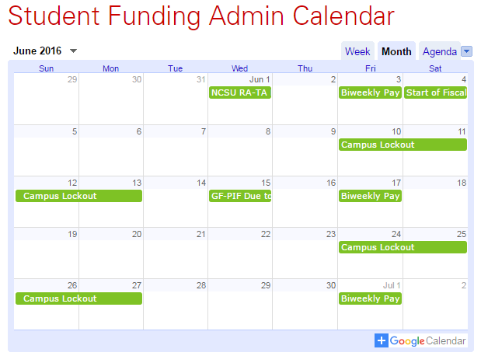
Calendar/Deadline Reminders
grad.ncsu.edu/faculty-and-staff/student-funding/
All appointments should be entered prior to the start date.
NextGen allows actions to be entered 60 days prior to the start of the appointment.
Auto-Term rows are entered Wednesday night, three weeks prior to the expected job end dates.
Rehires can not be entered until after the separation is entered and modification must be entered prior to the auto-term.
Check out the calendars on our website for more information!

Slide 49
NextGen Training
Starting at 1:30 pm, TODAY, in Room 210 of Parks Shop (this room!)
All are welcome to attend!

Slide 50
Graduate Fellowship Updates
Siarra Dickey

Slide 51
2016-2017 fellowship request form is up on the website.
The first August disbursement is 23, award forms due no later than the 15th to be paid out on time. (Please bare in mind the new GSSP dates.)
Keep up with fellowships using the “Fellowship Dept Summary” tool (SIS > Admin Services > Finances > Fellowship Dept Summary)
Fellowship updates coming!
Phase one will be implemented this week. This will be a face lift to portal view in preparation of phase two.
Phase two will come in 2017. This will move fellowship requests away from paper forms, and towards an electronic process.

Slide 52
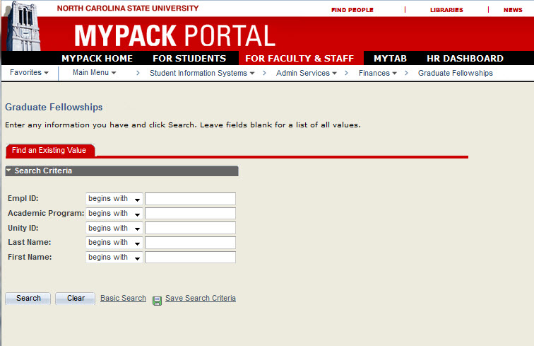
Login

Slide 53
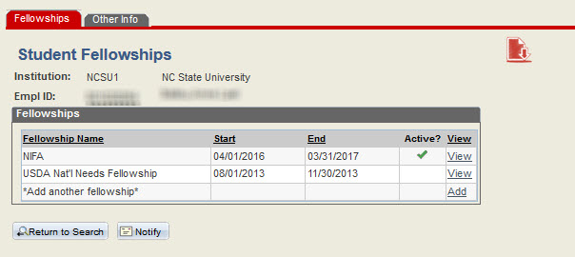
Fellowship Summary

Slide 54
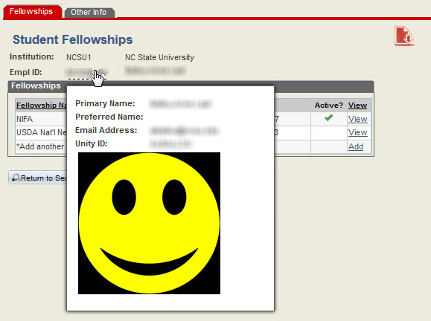
Fellowship Summary

Slide 55
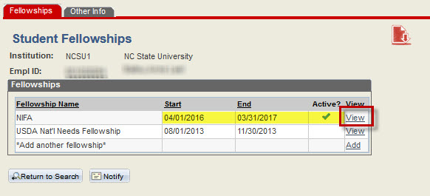
Select to View Detail of Fellowship

Slide 56
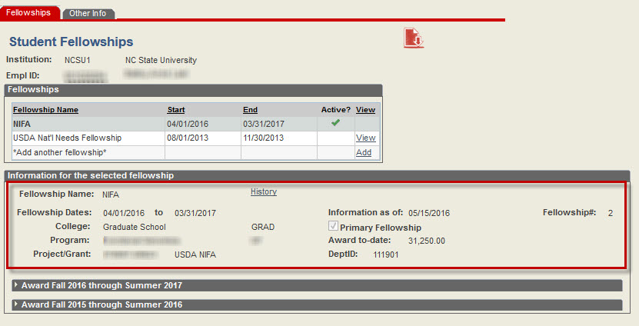
Fellowship Details Expanded

Slide 57
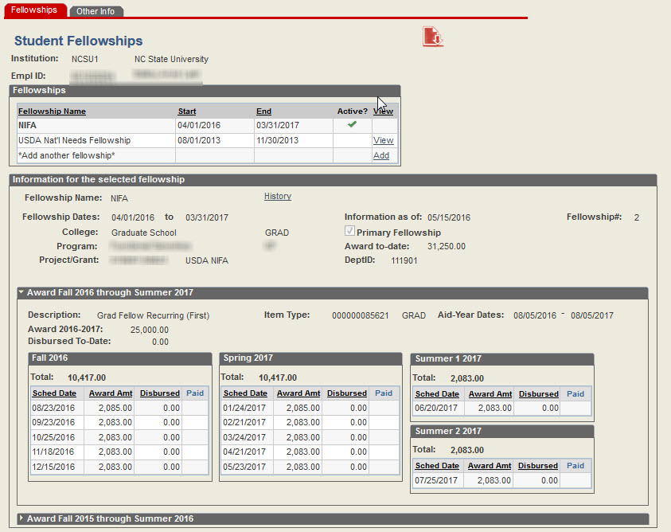
Fellowship Disbursement Expanded

Slide 58
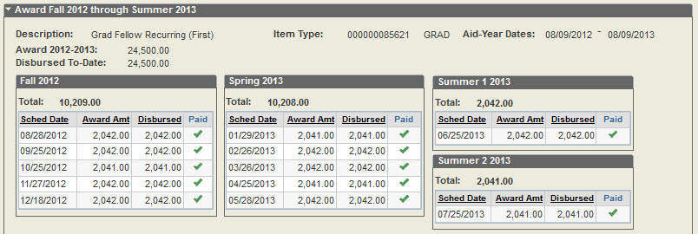
Fellowship Disbursement Expanded

Slide 59
Fellowship Disbursement Expanded

Slide 60
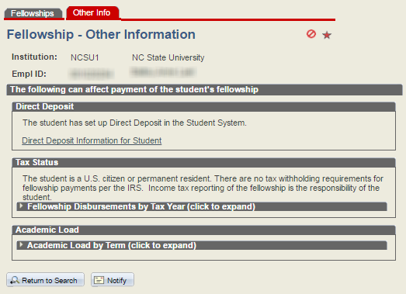

Slide 61
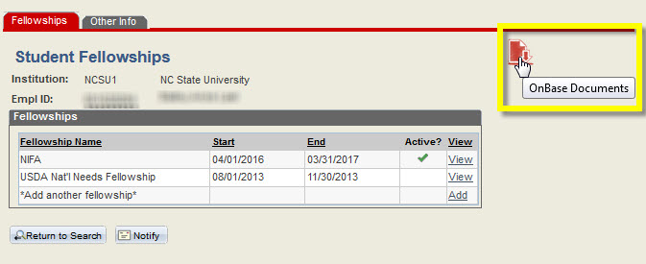
OnBase Documents

Slide 62
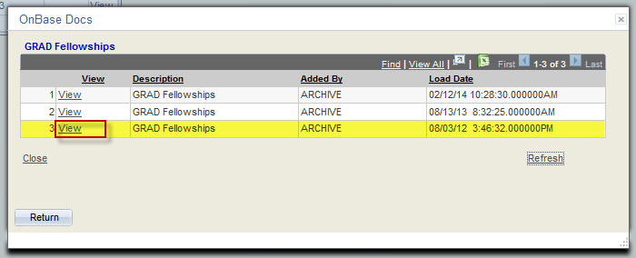
OnBase Documents

Slide 63
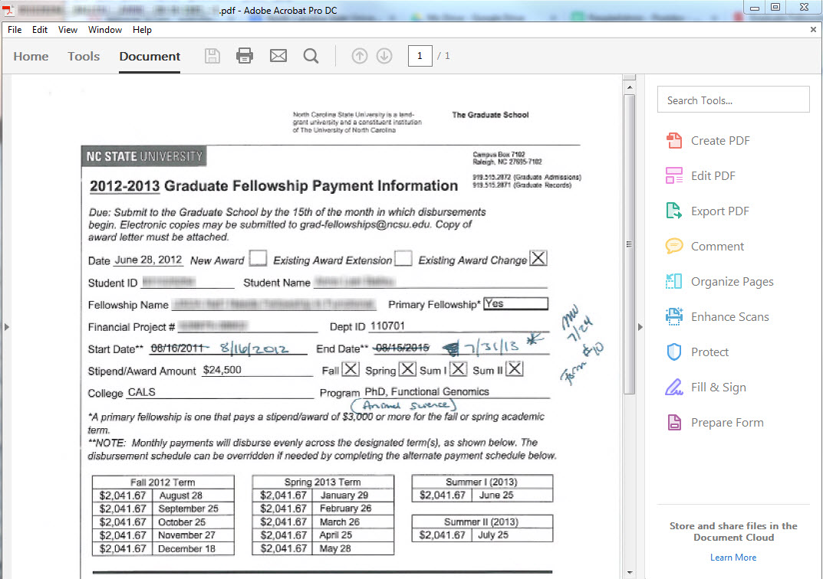
OnBase Documents

Slide 64
Questions?

Slide 65
Thank you for coming!

